Slide 1
UNIT -2
Network Services

Slide 2
Network Services in Linux
Services in Linux and other operating systems are applications or a set of applications that run in the background, enabling certain capabilities as and when they become necessary.

Slide 3
Required Services for Networking
The following three services are required for network activities on a Linux system:
network - This service turns on the network card, or powers the modem.
iptables - The kernel based Packet Filtering firewall service. Various Linux firewalls are based on this service. iptables is a command line interface used to set up and maintain tables for the Netfilter firewall for IPv4, included in the Linux kernel. The firewall matches packets with rules defined in these tables and then takes the specified action on a possible match.
Tables is the name for a set of chains.
Chain is a collection of rules.
Rule is condition used to match packet.
Target is action taken when a possible rule matches. Examples of the target are ACCEPT, DROP, QUEUE.
Policy is the default action taken in case of no match with the inbuilt chains and can be ACCEPT or DROP.

Slide 4
xinetd - The server that monitors and controls other servers. This service frees up CPU load by allowing other services like FTP (file transfer) to be available, but only run when needed, as opposed to running continuously and consuming unnecessary processing power.
The xinetd daemon is a TCP wrapped super service which controls access to a subset of popular network services including FTP, IMAP, and telnet. It also provides service-specific configuration options for access control, enhanced logging, binding, redirection, and resource utilization control.

Slide 5
Other Network Services
arpwatch - Monitors and pairs remote IP addresses with hostnames.
dhcpd - Enables the DHCP Server, to dynamically provide IP addresses to the local network. This is used in situations where the local network is large enough such that static IP addresses are no longer convenient.
iplog - A network monitoring tool that logs TCP, UDP and ICMP connections with hostnames of a remote host.
netplugd - The Network Card Daemon. It monitors the network interface and enables it or disables it depending on whether it detects a signal. It is used mainly for laptops, as they may not always be connected to a network.
nfs - The Network File Share service. Required for computers that are part of a network file sharing system.
nfsfs - The Network File Share Server. This service powers the computer which acts as the server in a network file sharing system.
nfslock - This service allows for NFS file locking in a network file sharing system.
saned - The Network Scanner Service; allows any machine on the network to use the scanner.
snmpd - The Simple Network Management Protocol. This service is used in a small network environment, like a home office network.

Slide 6
Introduction to TCP/IP
TCP/IP is an acronym for Transmission Control Protocol/Internet Protocol, and refers to a family of protocols used for computer communications.
TCP and IP are just two of the separate protocols contained in the group of protocols developed by the Department of Defense, sometimes called the DoD Suite, but more commonly known as TCP/IP.
In addition to Transmission Control Protocol and Internet Protocol, this family also includes Address Resolution Protocol (ARP), Domain Name System (DNS), Internet Control Message Protocol (ICMP), User Datagram Protocol (UDP), Routing Information Protocol (RIP), Simple Mail Transfer Protocol (SMTP), Telnet and many others.
These protocols provide the necessary services for basic network functionality.

Slide 7
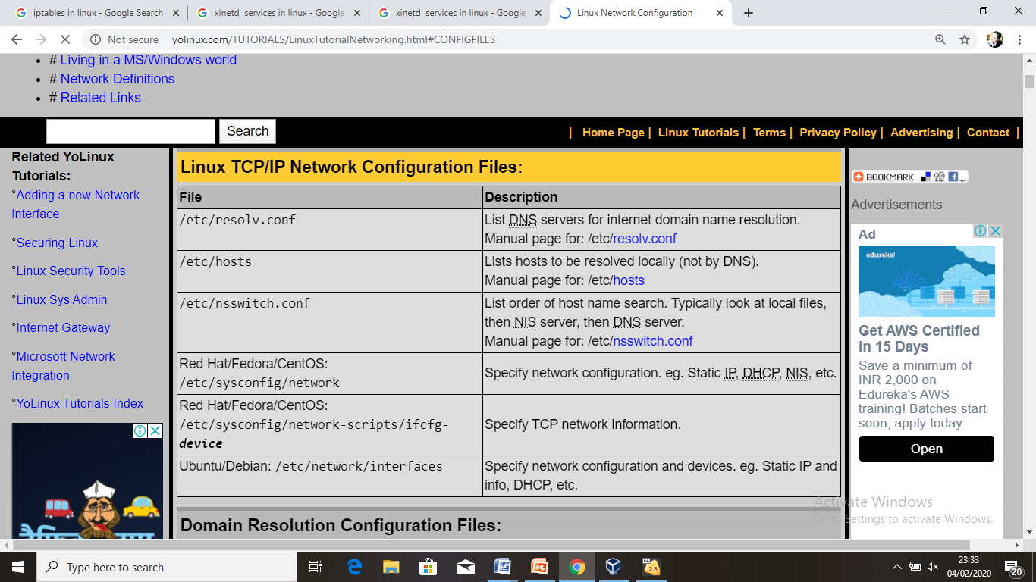

Slide 8
Understanding Network Classes
IP addresses are divided into classes with the most significant being classes A, B, and C depending on the value of the first byte of the address.
NETWORK CLASSES AND THEIR IP NUMBER RANGE
Class First Byte
Class A 0–127
Class B 128–191
Class C 192–233
The reason for the class division is to enable efficient use of the address numbers. If the division were the first two bytes to the network part and the last two bytes to the host part.

Slide 9
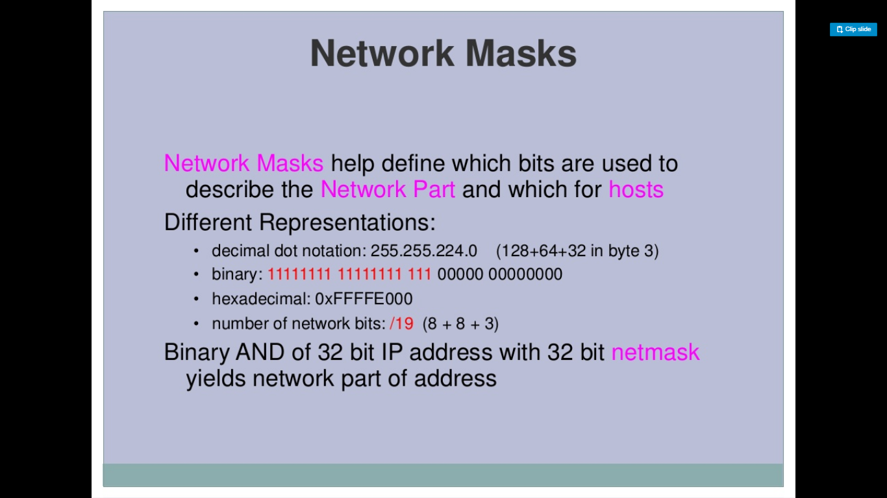

Slide 10
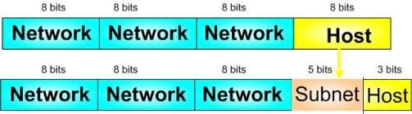
Network & host bits representation

Slide 11

Let's use IP address 192.168.10.44 with subnet mask 255.255.255.248 or /29.
STEP 1: Convert to Binary
STEP 2: Calculate the Subnet Address
To calculate the IP Address Subnet you need to perform a bit-wise AND operation (1+1=1, 1+0 or 0+1 =0, 0+0=0) on the host IP address and subnet mask.

Slide 12

STEP 3: Find Host Range
We know already that for subnetting this Class C address we have borrowed 5 bits from the Host field. These 5 bits are used to identify the subnets. The remaining 3 bits are used for defining hosts within a particular subnet.
The Subnet address is identified by all 0 bits in the Host part of the address. The first host within the subnet is identified by all 0s and a 1. The last host is identified by all 1s and a 0. The broadcast address is the all 1s.

Slide 13
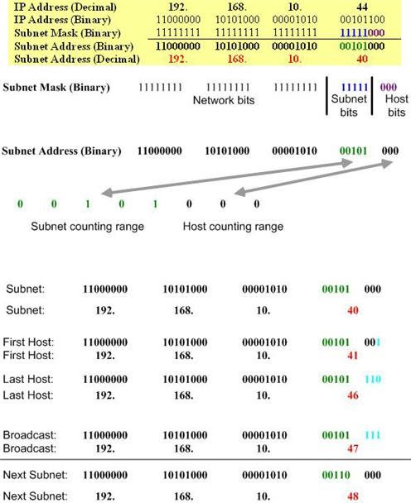

Slide 14
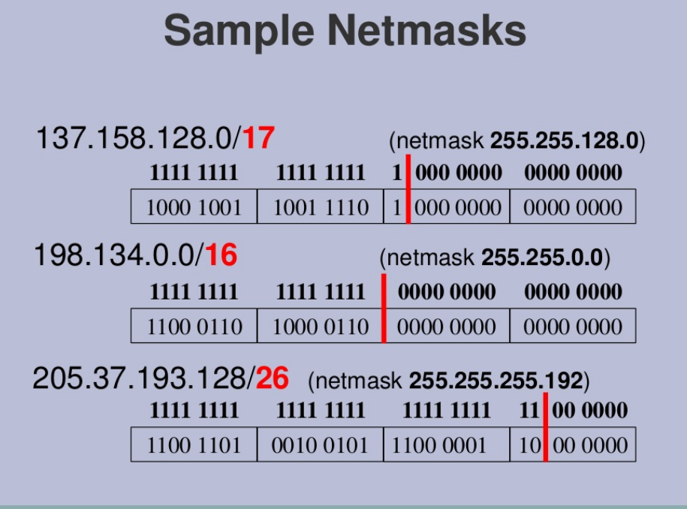

Slide 15
Solution
216 . 3 . 128 . (1000 0000)
216 . 3 . 128 . (1001 0000)
216 . 3 . 128 . (1010 0000)
216 . 3 . 128 . (1011 0000)
216 . 3 . 128 . (1100 0000)
216 . 3 . 128 . (1101 0000)
216 . 3 . 128 . (1110 0000)
216 . 3 . 128 . (1111 0000)
255 . 255 . 255 . (1111 0000) (Subnet mask of 255.255.255.240)

Slide 16
NETWORK INTERFACES
The configuration files for network interfaces are located in the /etc/sysconfig/network-scripts/ directory. The scripts used to activate and deactivate these network interfaces are also located here. Although the number and type of interface files can differ from system to system, there are three categories of files that exist in this directory:
Interface configuration files
Interface control scripts
Network function files

Slide 17
Network Configuration Files
The primary network configuration files are as follows:
/etc/hosts : The main purpose of this file is to resolve host names that cannot be resolved any other way. It can also be used to resolve host names on small networks with no DNS server.
/etc/resolv.conf: This file specifies the IP addresses of DNS servers and the search domain.
/etc/sysconfig/network: This file specifies routing and host information for all network interfaces.
etc/sysconfig/network-scripts/ifcfg-interface-name: For each network interface, there is a corresponding interface configuration script. Each of these files provide information specific to a particular network interface.

Slide 18
Setting Up a Network Interface Card (NIC)
Every Red Hat Linux distribution includes networking support and tools that can be used to configure your network.
if the computer is not connected to outside networks, an internal network functionality is required for some applications. This address is known as the loop- back and its IP address is 127.0.0.1. You should check that this network interface is working before configuring your network cards.
To do this, you can use the ifconfig utility to get some information. If you type ifconfig at a console prompt, you will be shown your current network interface configuration.

Slide 19
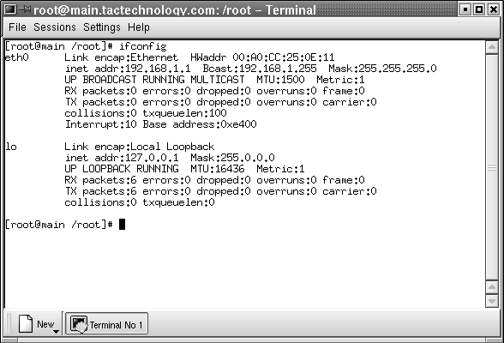

Slide 20
……
If your loopback is configured, the ifconfig shows a device called lo with the address 127.0.0.1. If this device and address are not shown, you can add the device by using the ifconfig command as follows:
ifconfig lo 127.0.0.1
You then need to use the route command to give the system a little more infor- mation about this interface. For this you type:
route add -net 127.0.0.0
You now have your loopback set up and the ifconfig command shows the device lo in its listing.

Slide 21
Configuring the network card
Configuring a network card follows the same procedure as configuring the loop- back interface. You use the same command, ifconfig, but this time use the name ‘eth0’ for an Ethernet device.
You also need to know the IP address, the netmask, and the broadcast addresses. These numbers vary depending on the type of network being built.
For an internal network that never connects to the outside world, any IP numbers can be used, however there are IP numbers typically used with these networks.
If you are connecting to an existing network, you must have its IP address, net- mask, and broadcast address. You also need to have the router and domain name server addresses.

Slide 22
…..
In this example, you configure an Ethernet interface for an internal network.
You need to issue the command:
ifconfig eth0 192.168.1.1
netmask 255.255.255.0
broadcast 192.168.1.255
this results in the creation of device eth0 with a network address of 192.168.1.1, a netmask of 255.255.255.0 and a broadcast address of 192.168.1.255.
A file is created in /etc/sysconfig/network-scripts called ifcfg-eth0. A listing of this file would show the information that you just entered. The line onboot=yes tells the kernel to configure this device at system startup.

Slide 23
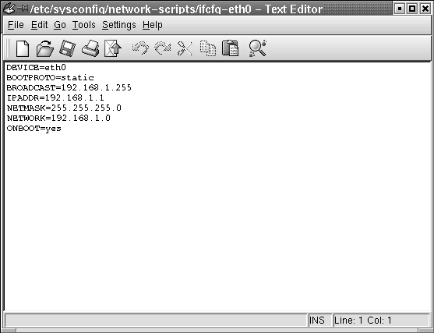

Slide 24
Classless Inter Domain Routing (CIDR)
CIDR was invented several years ago to keep the Internet from running out of IP addresses.
Classless inter domain routing is a set of internet protocol standards that is used to create unique identifiers for networks and individual devices.
The IP addresses allow particular information packet to be sent to specific computers.
It consist of two group of numbers which are also referred to as group of bits.
The most important of these groups is the network address and it is used to identify the network and sub network.

Slide 25
Dynamic Host Configuration Protocol (DHCP)
Dynamic Host Configuration Protocol (DHCP) is a client/server protocol that automatically provides an Internet Protocol (IP) host with its IP address and other related configuration information such as the subnet mask and default gateway. The Dynamic Host Configuration Protocol (DHCP) is a network service that enables host computers to be automatically assigned settings from a server as opposed to manually configuring each network host. Computers configured to be DHCP clients have no control over the settings they receive from the DHCP server, and the configuration is transparent to the computer's user.
The most common settings provided by a DHCP server to DHCP clients include:
IP address and netmask
IP address of the default-gateway to use
IP addresses of the DNS servers to use
However, a DHCP server can also supply configuration properties such as:
Host Name
Domain Name
Time Server
Print Server

Slide 26
Benefits of using DHCP
DHCP provides the following benefits.
Reliable IP address configuration. DHCP minimizes configuration errors caused by manual IP address configuration, such as typographical errors, or address conflicts caused by the assignment of an IP address to more than one computer at the same time.
Reduced network administration. DHCP includes the following features to reduce network administration:
Centralized and automated TCP/IP configuration.
The ability to define TCP/IP configurations from a central location.
The ability to assign a full range of additional TCP/IP configuration values by means of DHCP options.
The efficient handling of IP address changes for clients that must be updated frequently, such as those for portable devices that move to different locations on a wireless network.
The forwarding of initial DHCP messages by using a DHCP relay agent, which eliminates the need for a DHCP server on every subnet.

Slide 27
The advantage of using DHCP is that changes to the network, for example a change in the address of the DNS server, need only be changed at the DHCP server, and all network hosts will be reconfigured the next time their DHCP clients poll the DHCP server. As an added advantage, it is also easier to integrate new computers into the network, as there is no need to check for the availability of an IP address. Conflicts in IP address allocation are also reduced.

Slide 28
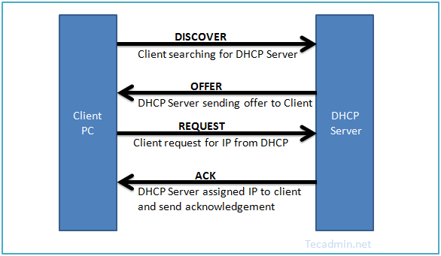
DHCP Configuration
DHCP (Dynamic Host Configuration Protocol) is a network protocol used for assigning IP address to network clients dynamically from a predefined IP pool. It is useful for LAN network, but not generally used for production servers.

Slide 29
Install DHCP Package
First install DHCP packages using yum package manager on CentOS, Red Hat systems. DHCP rpms are available under base repositories, so we don’t need to add an extra repository.
yum install dhcp
Update /etc/sysconfig/dhcpd File
Firstly we need to set ethernet interface name as DHCPDARGS in /etc/sysconfig/dhcpd file. Edit this configuration file and update the ethernet name.
DHCPDARGS=eth1

Slide 30
Configure DHCP Server
DHCP creates an empty configuration file /etc/dhcp/dhcpd.conf. Also it provides a sample configuration file at /usr/share/doc/dhcp*/dhcpd.conf.sample, which is very useful for configuring the DHCP server.
# cp /usr/share/doc/dhcp-4.1.1/dhcpd.conf.sample /etc/dhcp/dhcpd.conf
Parameter Configuration
First configure the basic options which is common to all supported networks.
option domain-name “tecadmin.net";
option domain-name-servers ns1.tecadmin.net, ns2.tecadmin.net; default-lease-time 600;
max-lease-time 7200;
authoritative;
log-facility local7;

Slide 31
IP Subnet Declaration
First, edit DHCP configuration file and update subnet details as per your network. For this example we are configuring DHCP for 192.168.1.0/24 LAN network.
subnet 192.168.1.0 netmask 255.255.255.0
{
option routers 192.168.1.254;
option subnet-mask 255.255.255.0;
option domain-search “tecadmin.net";
option domain-name-servers 192.168.1.1;
option time-offset -18000; # Eastern Standard Time
range 192.168.1.10 192.168.1.100;
}

Slide 32
Assign Static IP Address to Host
In some cases, we need to assign a fixed IP to an interface each time it requested from dhcp. We can also assign a fixed IP on basis of MAC address (hardware ethernet) of that interface. Setup host-name is optional to set up.
host station1
{
option host-name "station1.example.com";
hardware ethernet 00:11:1A:2B:3C:AB;
fixed-address 192.168.1.100;
}
Start DHCP Service
After making all above changes, let’s start dhcp service using following commands as per your operating system version.
For CentOS/RHEL 7
systemctl start dhcp
For CentOS/RHEL 6/5
service dhcp start

Slide 33
Similarly to stop and restart dhcp service use following commands.
For CentOS/RHEL 7
systemctl stop dhcp
ystemctl restart dhcp
For CentOS/RHEL 6/5
service dhcp stop
service dhcp restart

Slide 34
Setup Client System
Now login to that client machine and edit Ethernet configuration file.
vim /etc/sysconfig/network-scripts/ifcfg-eth1
DEVICE=eth1
BOOTPROTO=dhcp
TYPE=Ethernet
ONBOOT=yes
Make sure BOOTPROTO is set to dhcp.
Let’s restart network services on the client machine. You will get that dhcp server assigned an ip address from the defined subnet. If you have connected to client pc from remote login, Your session can be disconnected.
For CentOS/RHEL 7
systemctl restart network
For CentOS/RHEL 6/5
service network restart

Slide 35
What is systemctl?
systemctl is a controlling interface and inspection tool for the widely-adopted init system and service manager systemd.
Managing Services
systemd initializes user space components that run after the Linux kernel has booted, as well as continuously maintaining those components throughout a system’s lifecycle. These tasks are known as units, and each unit has a corresponding unit file. Units might concern mounting storage devices (.mount), configuring hardware (.device), sockets (.socket), or, as will be covered in this guide, managing services (.service).
Starting and Stopping a Service
To start a systemd service in the current session, issue the start command:
sudo systemctl start apache2.service

Slide 36
Cntd..
The systemctl command is a new tool to control the systemd system and service. This is the replacement of old SysV init system management. Most of modern Linux operating systems are using this new tool.

Slide 37
Other network services
ntpd – Network Time Protocol Daemon
httpd – Hyper Text Transfer Protocol Daemon
sshd – Secure SHell Daemon
sendmail – Mail Server Daemon
snmpd – Simple Network Management Protocol Daemon
iptables – Network Filtering Protocol Service
nfsd – Network File System Server Daemon
nscd – Name Service Cache Daemon
named – Dynamic Naming Service Server Daemon
smbd – Simple Message Block Server Daemon

Slide 38
ntpd
This service executes the Network Time Protocol (NTP) daemon ntpd. The purpose is to synchronize the time of the local computer to a NTP server or other reference time source such as a radio or satellite receiver or modem. The NTP system uses two main roles for participating computers: server or client. Time servers supply time to one or more NTP clients. NTP clients use the reference time from one or more NTP servers to determine the local time.
Service management :
# /sbin/service ntpd usage: /etc/init.d/ntpd {start|stop|restart|condrestart|status}
Configuration File :
/etc/ntp.conf

Slide 39
httpd
httpd is the Apache Hyper Text Transfer Protocol (HTTP) server program. It is designed to be run as a standalone daemon process. When used like this it will create a pool of child processes or threads to handle requests.
In general, httpd should not be invoked directly, but rather should be invoked via apachectl on Unix-based systems.
The httpd RPM package provides the /usr/sbin/httpd daemon and its configuration files.
Service Management:
/sbin/service httpd show Usage: httpd {start|stop|restart|condrestart|reload|status|fullstatus|graceful|help|configtest}
Configuration file:
/etc/httpd/conf/httpd.conf

Slide 40
sshd
The sshd (Secure Shell Daemon) service is part of the OpenSSH implementation for Linux that provides authenticated, end-to-end encrypted networked communication.
For example, a user on one host can log in to another system without using a password because the sshd service can be configured to use alternate authentication techniques such as exchanging shared-key information.
The openssh-server RPM package provides the /usr/sbin/sshd daemon and its configuration files
Two versions of the SSH communication protocol exist, version 1 and version 2. Connections between the client and the sshddaemon are made on TCP/IP port 22 by default, using either UDP or TCP protocols.
Service Management:
To manage the sshd service on demand, use the service tool or run the /etc/init.d/sshd script directly:
# /sbin/service sshd help Usage: /etc/init.d/sshd {start|stop|restart|reload|condrestart|status} # /etc/init.d/sshd help Usage: /etc/init.d/sshd {start|stop|restart|reload|condrestart|status}
Configuration File for SSHD:
/etc/ssh/sshd_config

Slide 41
Sendmail
This executes Mail Server Daemon which runs as a daemon in the background, listening for incoming mail from other machines.
Service Management:
Usage: /etc/init.d/sendmail {start|stop|restart|condrestart|status}
Configuration File:
/etc/mail/sendmail.cf

Slide 42
snmpd
The snmpd service is an SNMP(Simple Network Management Protocol) agent which binds to a port and awaits requests from SNMP management software. By using snmp, you can obtain the statistics of the server, which is described by MIB file from remote host.
Service Management:
To manage the service on demand, use the service(8) tool or run the /etc/init.d/snmpd script directly:
# /sbin/service snmpd help Usage: /etc/init.d/snmpd {start|stop|status|restart|condrestart|reload} # /etc/init.d/snmpd help Usage: /etc/init.d/snmpd {start|stop|status|restart|condrestart|reload}
Configuration File:
/etc/snmp/snmpd.conf

Slide 43
iptables
The iptables utility controls the network packet filtering code in the Linux kernel. If you need to set up firewalls and/or IP masquerading, you should install this tool.
Service Management
# service iptables Usage: /etc/init.d/iptables {start|stop|restart|condrestart|status|panic|save}
Configuration File
/etc/sysconfig/iptables – iptables rules /etc/sysconfig/iptables-config – iptables configuration

Slide 44
nfsd
The Network File System (NFS) is a server/client based networking protocol. NFS daemons are composed by nfsd, rpc.mountd, rpc.rquotad, rpc.lockd
– Daemon nfsd:
nfsd handles client requests from remote systems. Multiple copies of this daemon are usually run so that several requests can be handled simultaneously. However, too many copies of nfsd can increase the demand for CPU time to the point where a drop in performance results. For the best performance the number of copies of nfsd should be set to four.
– Daemon rpc.mountd:
rpc.mountd handles mount requests from remote systems.
– Daemon rpc.rquotad:
It is a rpc server which returns quotas for a user of a local file system which is NFS-mounted onto a remote machine.
– Daemon rpc.lockd:
rpc.lockd manages file locking on NFS client and server machines.

Slide 45
nscd
This is the Name Service Cache Daemon. It takes care of group and password lookups for running programs and then caches the lookup results for the next query for services that can experience slowness in picking up changes such as NIS or LDAP. If you’re running these services, you may want to run nscd.
Service Management:
Usage: /etc/init.d/nscd {start|stop|status|restart|reload|condrestart}
Configuration File:
/etc/nscd.conf

Slide 46
named
named actually executed DNS ( Dynamic naming Service) server daemon. It converts host names to IP addresses and vice versa. There are several different kinds of DNS servers, such as primary server, slave server and cached server etc. Its data is stored in the directory /var/named. The data stored in the DNS is identified by domain names that are organized as a tree according to organizational or administrative boundaries
Service Management
# /sbin/service named Usage: /etc/init.d/named
{
start|stop|status|restart|condrestart|reload|probe
}
Configuration File
/etc/named.conf

Slide 47
smbd
The Samba software suite is a collection of programs that implements the SMB protocol for UNIX systems. This protocol is also known as the Common Internet File System (CIFS). The NetBIOS protocol is implemented by the nmbd daemon.
The SMB server daemon smbd provides file sharing and printing services to Windows clients. The server provides file space and printer services to clients via the SMB/CIFS protocol.
The nmbd daemon is a NetBIOS name server that provides NetBIOS naming services to clients . It understands and can reply to NetBIOS over IP name service requests, like those produced by SMB/CIFS clients (windows).
Service Control
# /sbin/service smb Usage: /etc/init.d/smb {start|stop|restart|reload|status|condrestart}
Configuration File
/etc/samba/smb.conf

